Slide 1
Machine learning assisted optimization of High speed and hybrid full adder based 4 bit digital comparator
3rd International Conference on Sustainable Computing and Data Communication Systems
Presented by:
1. P. Sathvik Kumar

Slide 2

Abstract
The full adder, a crucial component of the Arithmetic Logic Unit (ALU) and a fundamental functional unit in Digital Signal Processors (DSPs) and microprocessors, is used in this study to construct a 4-bit magnitude comparator. In modern VLSI design, low-power circuit design has emerged as a crucial area of concentration. The power consumption of various 4-bit magnitude comparator systems is compared in this research. The comparator uses a design based on various full adder types, including a conventional full adder, a full adder with two XNOR gates and one multiplexer, a 2×1 multiplexer-based full adder, a NAND gate-based full adder, and an XOR-XNOR with multiplexer-based full adder, to determine whether one binary number is greater than, equal to, or less than another. A machine learning (ML) technique is incorporated to model and forecast power, delay, and area metrics under process-voltage-temperature (PVT) fluctuations to improve the performance evaluation. During the early stages of design space exploration, this prediction model helps choose the most effective design configuration. According to simulation results utilising Cadence tools in 45nm technology, the most power-delay efficient solution for low-power digital comparator applications is obtained by combining ML-driven Optimisation with a 4-bit digital magnitude comparator employing complete adder architecture by providing quick and precise estimations without the need for extensive simulations, the hybrid methodology greatly enhances design decisions

Slide 3
VLSI SCALING:
In order to achieve the growth or to raise the success of VLSI industry,
the scaling of devices has significant role that results in dense and faster integration of the device by utilizing small area.
The technology moving towards the very large submicron region, the processing capacity per chip and operating frequency increases rapidly which in turn results in increased power dissipation and leakage current and circuit reliability become the key issue. Hence the overall performance of the circuit is affected.
Reliability is also an important issue which points to the need for low power design. So, VLSI designers have to make the balance in performance of the circuits and power dissipation with the scaling in technology.
The MOS transistors are the basic element of integrated circuits. By performing the scaling on MOS characteristics, it will improve its size, cost and performance.
There are various scaling methods by which scaling can be done on VLSI circuits. By varying the one parameter, it will affect the performance of another. The various methods of scaling are:

Slide 4
Voltage Scaling: With the reduction in supply voltage, the power dissipation of the circuit can be reduced at a constant clock frequency but on the other hand the propagation delay increases. This is shown by the relation given as: T= CL VDD/l
=>The drawback of voltage scaling is that some circuit styles cannot function at low supply voltage.
Load Scaling: It is another method to improve the performance of the circuit by reducing the power dissipation. If load capacitance is large, it draws more power supply hence increases dynamic power dissipation. So, scaling is to be done in terms of load capacitance.
Technology Scaling: To optimize the high performance of the circuit, CMOS technology has to be scale down continuously. With the new technology generation, overall lateral and vertical dimensions of the transistor are scaled down by a factor. And also, if there will be certain limit after which if further scaling in technology will be there then number of limitation factor arises like sub-threshold conduction, body effect, short channel effect etc.
Transistor Sizing (Width Scaling): It is also called channel width scaling. As the width of the transistor reduces, the power dissipation gets reduced and also there will be reduction in area of the circuit. On the other side, the propagation delay decreases if there will be increase in transistor width.

Slide 5
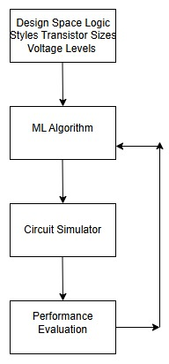
Automated design optimization loop using Machine Learning (ML) for circuit design and performance tuning
1.Design Space (Input Parameters)
Includes logic styles, transistor sizes, voltage levels, and other design parameters.
Represents the range of possible configurations for a circuit.
This space defines what can be optimized.
2.ML Algorithm
Machine Learning is used to predict or select optimal configurations from the design space.
It learns from previous simulations and performance data.
Can use techniques like Bayesian optimization, reinforcement learning, or regression models.
It helps narrow down the best designs faster than brute-force searching.
3. Circuit Simulator
Simulates the actual behavior of the selected design.
Common tools: Cadence Virtuoso, LT spice etc.
Provides data such as : Delay ,Power consumption ,Area ,Reliability
4. Performance Evaluation
Evaluates the simulated results based on desired metrics like Speed , Power, Area, Energy-Delay Product (EDP)
Compares the performance of different configuration
Fig. 1. Digital Magnitude Comparator using machine learning algorithm

Slide 6
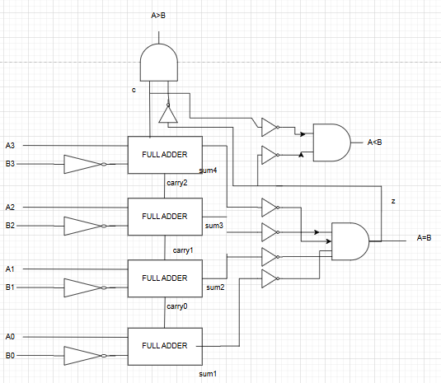
Block Diagram(4 BIT COMPARATOR)

Slide 7
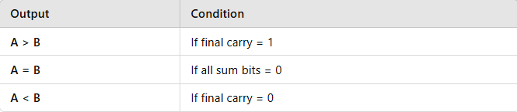
Comparator
1. Inputs and Outputs
🔹 Inputs:
A3,A2,A1,A0 First 4-bit binary number (A).
B3,B2,B1,B0 Second 4-bit binary number (B).
🔹 Outputs:
A>B High if A is greater than B.
A=B High if A is equal to B.
A<B High if A is less than B.
Step 1:
Each pair of bits from A and B is fed into the full adders along with the inverted bits from B.
🔸 Step 2:
Full adders perform the subtraction using two's complement.
The carry output from each full adder propagates to the next stage.
🔸 Step 3:
If all the sum outputs are zero, the AND gate will output a high signal, confirming that A=BA = BA=B.
🔸 Step 4:
If the final carry output is high, it implies that A > B; if low, A < B.

Slide 8
Full adder
It produces two outputs:
Sum (S) – Result of binary addition.
Carry-out (C out) – Carry generated to the next stage.
Boolean Expressions:
Sum (S) = A ⊕ B ⊕ Cin
Carry-out (C out) = (A ⋅ B) + (Cin ⋅ (A ⊕ B))
Implementation:
Can be implemented using logic gates (XOR, AND, OR).
Often used in cascading to form multi-bit adders (e.g., Ripple Carry Adder)
We have implemented:
1.Traditional Full adder
2.Full adder using 2X1 Multiplexer
3. Full adder using 1-Xnor 1-Xor and 2 Mux
4. Full adder using Nand Gate
5.Full adder using 2 X-nor 1 Multiplexer

Slide 9
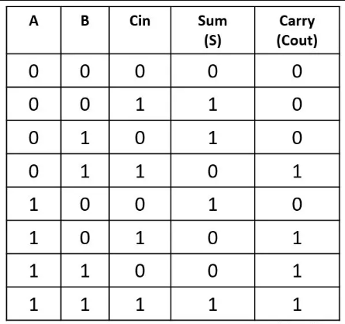
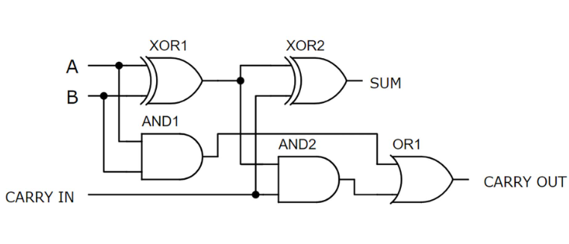
Traditional Full adder

Slide 10
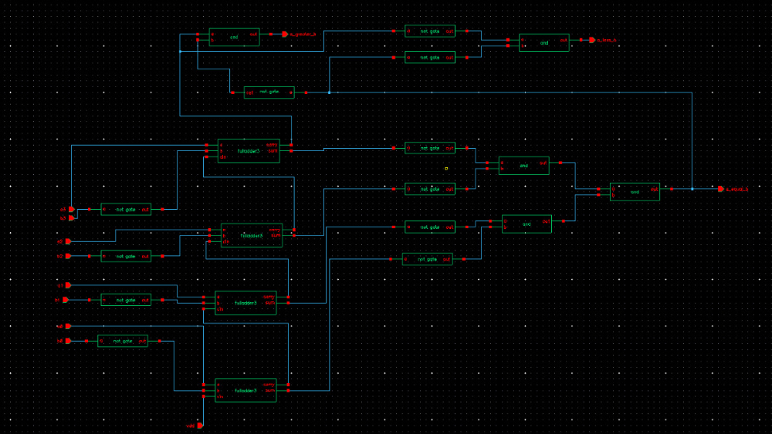
4 BIT COMPARATOR USING TRADITIONAL FULL ADDER

Slide 11
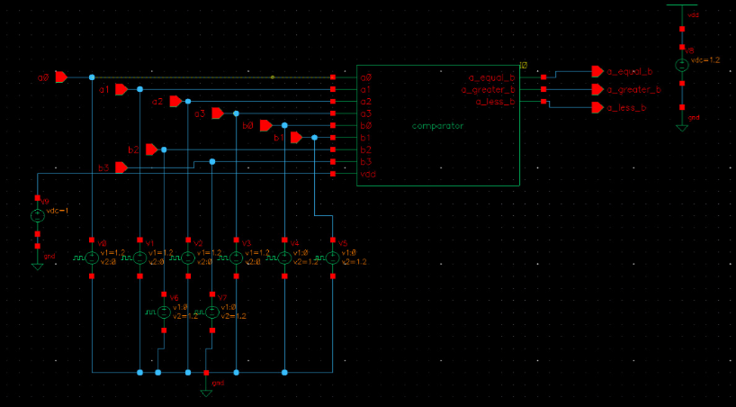
4 BIT COMPARATOR USING TRADITIONAL FULL ADDER-TEST BENCH

Slide 12
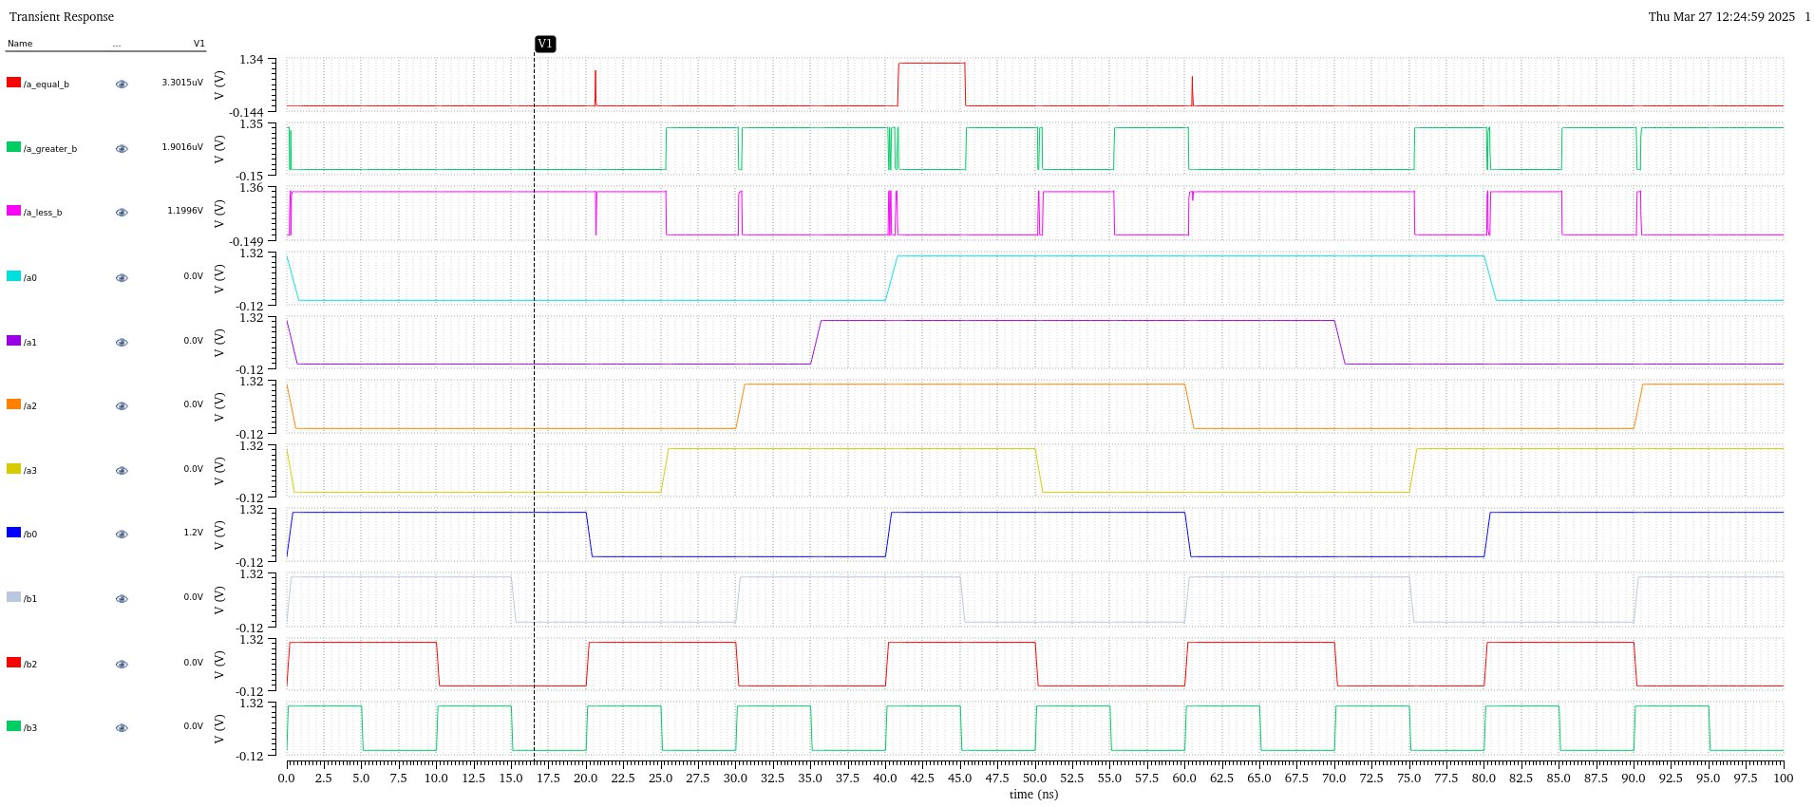
4 BIT COMPARATOR USING TRADITIONAL FULL ADDER(output)

Slide 13
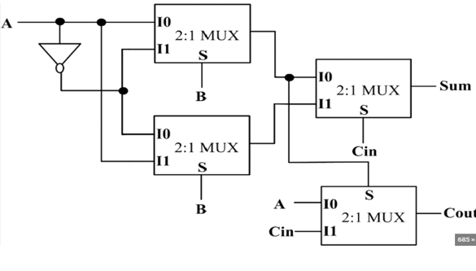
FULL ADDER USING 2X1 MULTIPLEXER

Slide 14
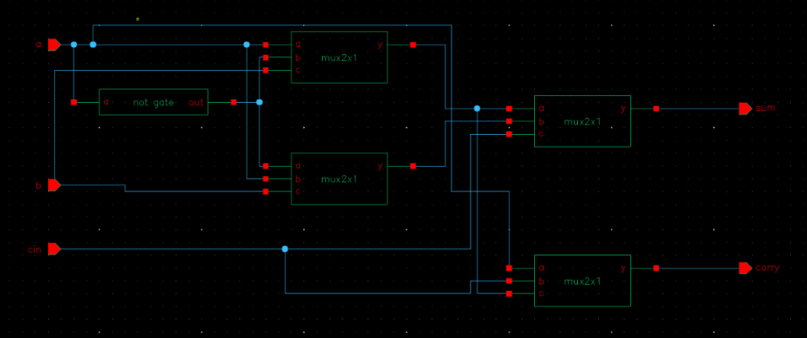
FULL ADDER USING MULTIPLEXER

Slide 15
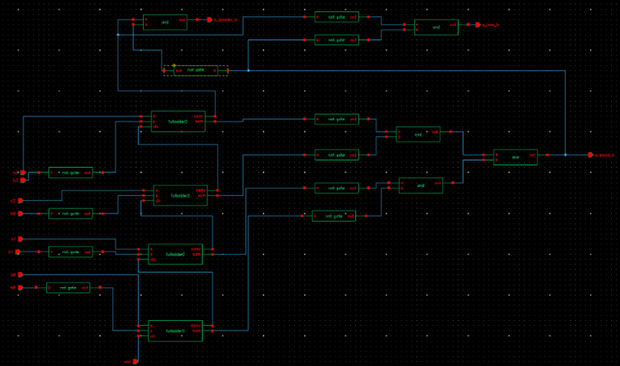
4 BIT COMPARATOR USING FA(2X1MUX)

Slide 16
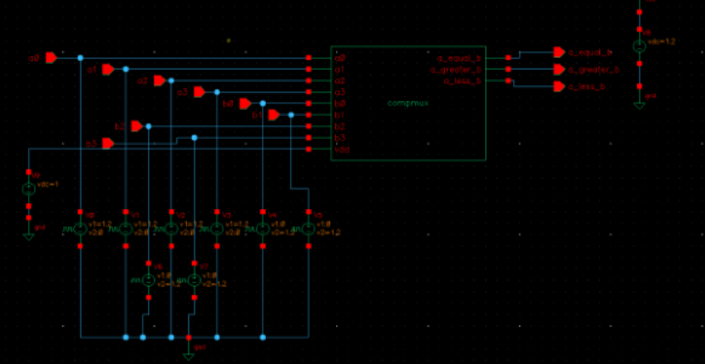
4 BIT COMPARATOR USING FA(2X1MUX) –TEST BENCH

Slide 17
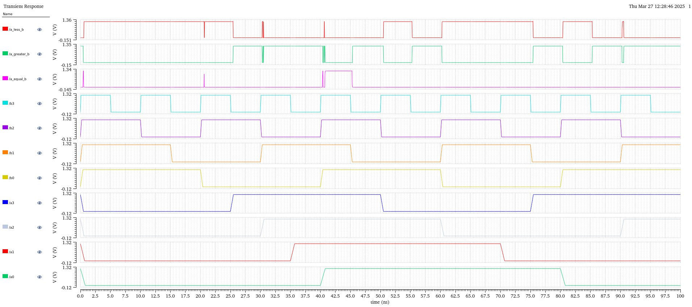
4 BIT COMPARATOR USING FA(2X1MUX) –OUTPUT

Slide 18
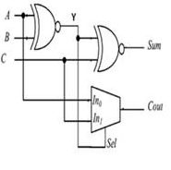
Full adder using 2xnor and 1 mux
First XOR gate
Inputs → A,BA, BA,B
Output →Y=A⊕B
Second XOR gate
Inputs → Y,C
Output (Sum) → (A⊕B)⊕C
Multiplexer for Carry-out
Inputs →
In0=A
In1​=Y
Selection Line → C
Output →Cout​=C⋅Y+C⋅A
➔> Cout​=C⋅(A⊕B)+C⋅A

Slide 19
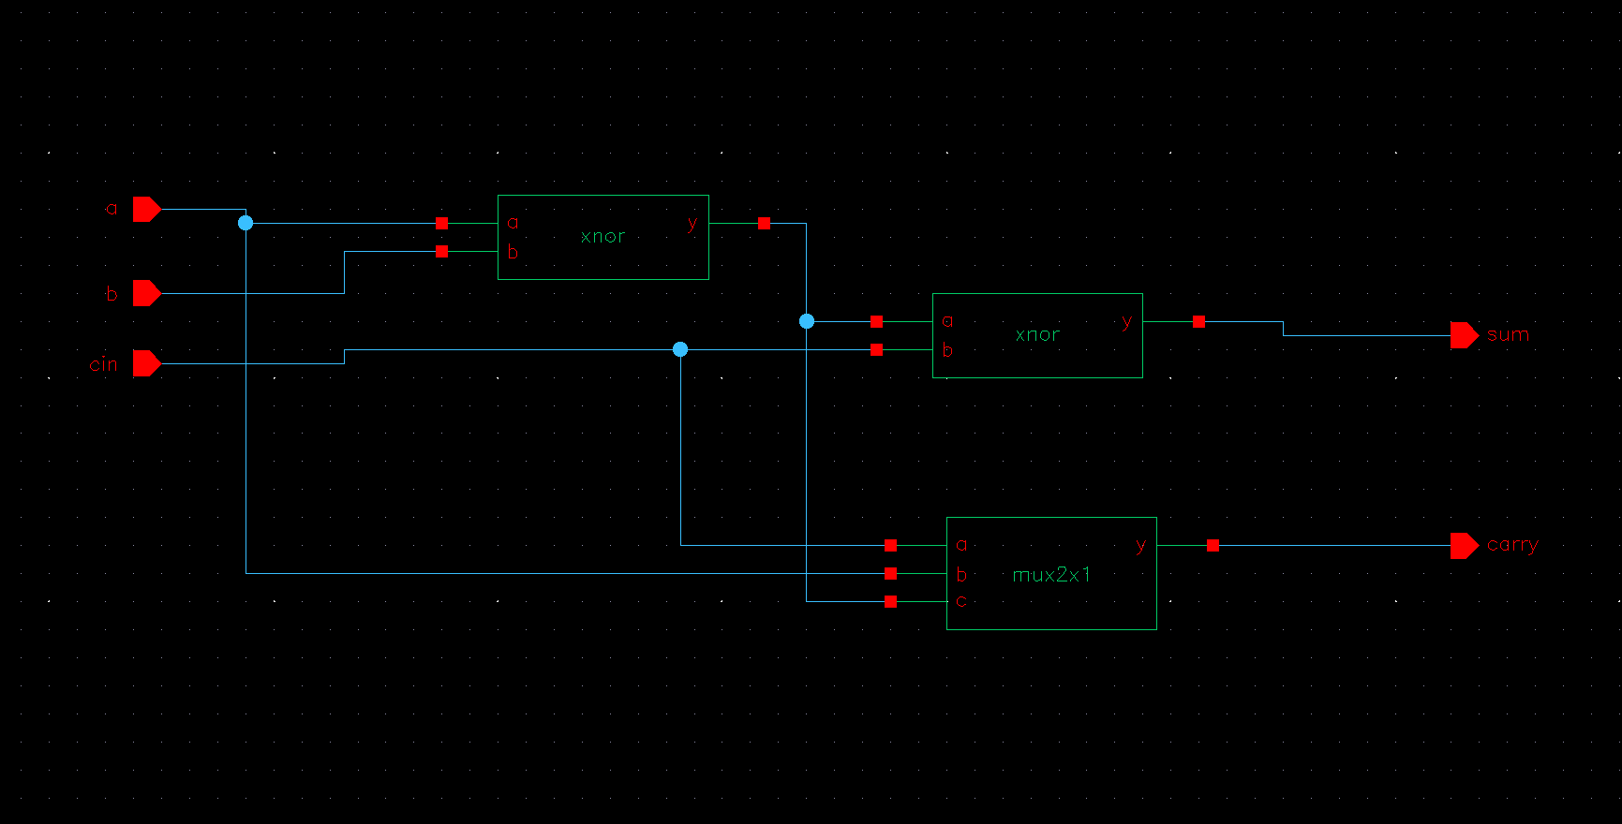
FULL ADDER USING 2XNOR AND 1 MUX

Slide 20
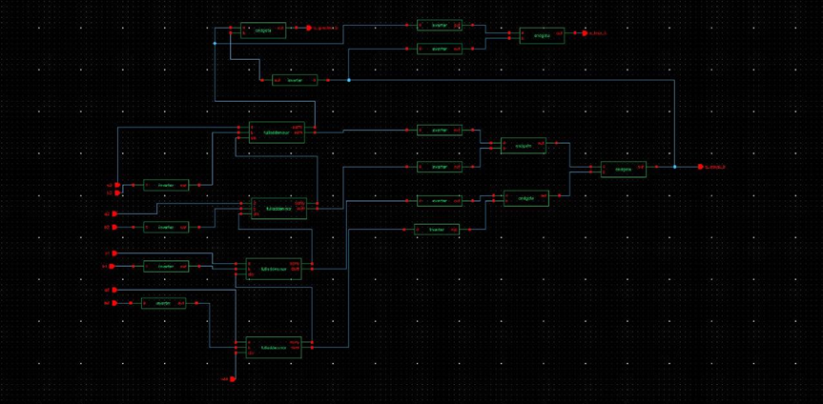
4-BIT COMPARATOR USING 2XNOR 1 MUX

Slide 21
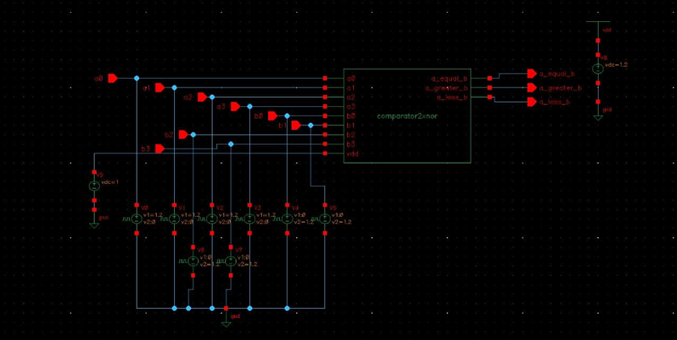
4 BIT COMPARATOR USING FA(2XNOR 1 MUX) –TEST BENCH

Slide 22
4 BIT COMPARATOR USING FA(2 XNOR 1 MUX) –OUTPUT

Slide 23
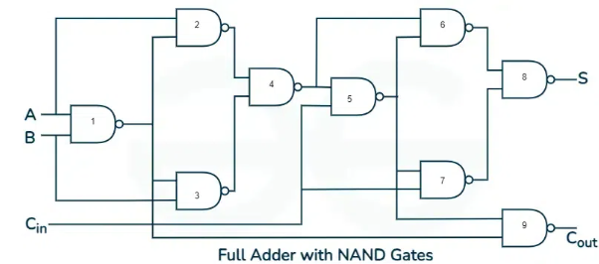
FULL ADDER USING UNIVERSAL GATES(NAND GATE)
NAND-based full adder works like this::
NAND gate 1 – Generates the complement of the AND operation of inputs A and B.
NAND gates 2 and 3 – Generate the intermediate terms for XOR operation (using the fact that XOR can be built from NAND gates).
NAND gates 4 and 5 – Combine intermediate results to generate the sum output (S).
NAND gates 6 and 7 – Generate the carry output terms using the same principle as AND gates.
NAND gates 8 and 9 – Finalize the sum and carry outputs.

Slide 24
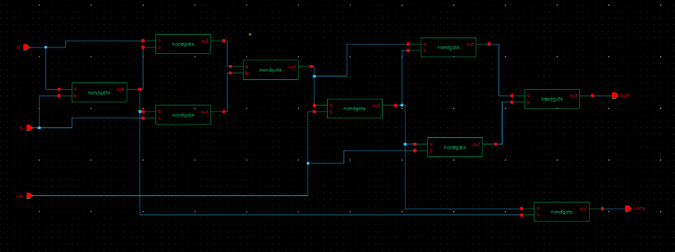
FULL ADDER USING UNIVERSAL GATES(NAND GATE)-32 TRANSISTOR COUNT
NAND gates are considered universal gates – any logic circuit can be constructed using only NAND gates.
Full adders using NAND gates are efficient in terms of gate minimization and cost reduction.

Slide 25
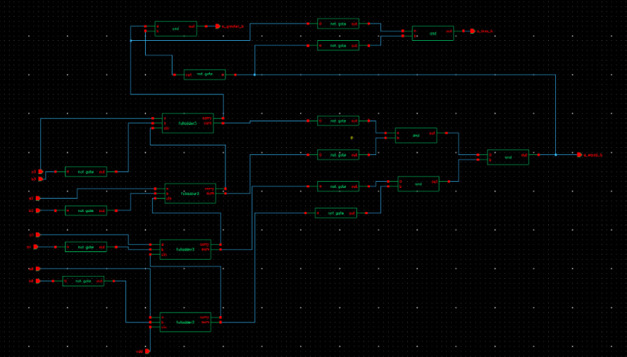
4-BIT COMPARATOR USING FA(NAND GATES)

Slide 26
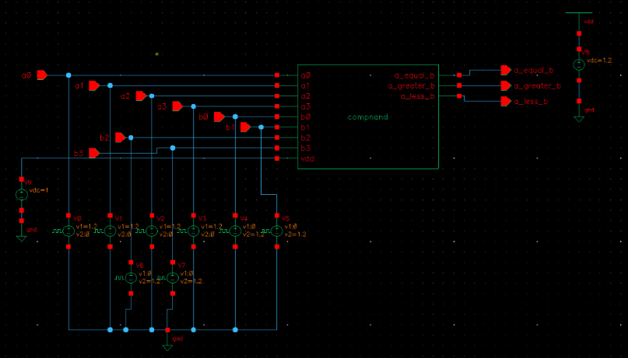
NAND GATE FULL ADDER SYMBOL AND POWER CONNECTIONS

Slide 27
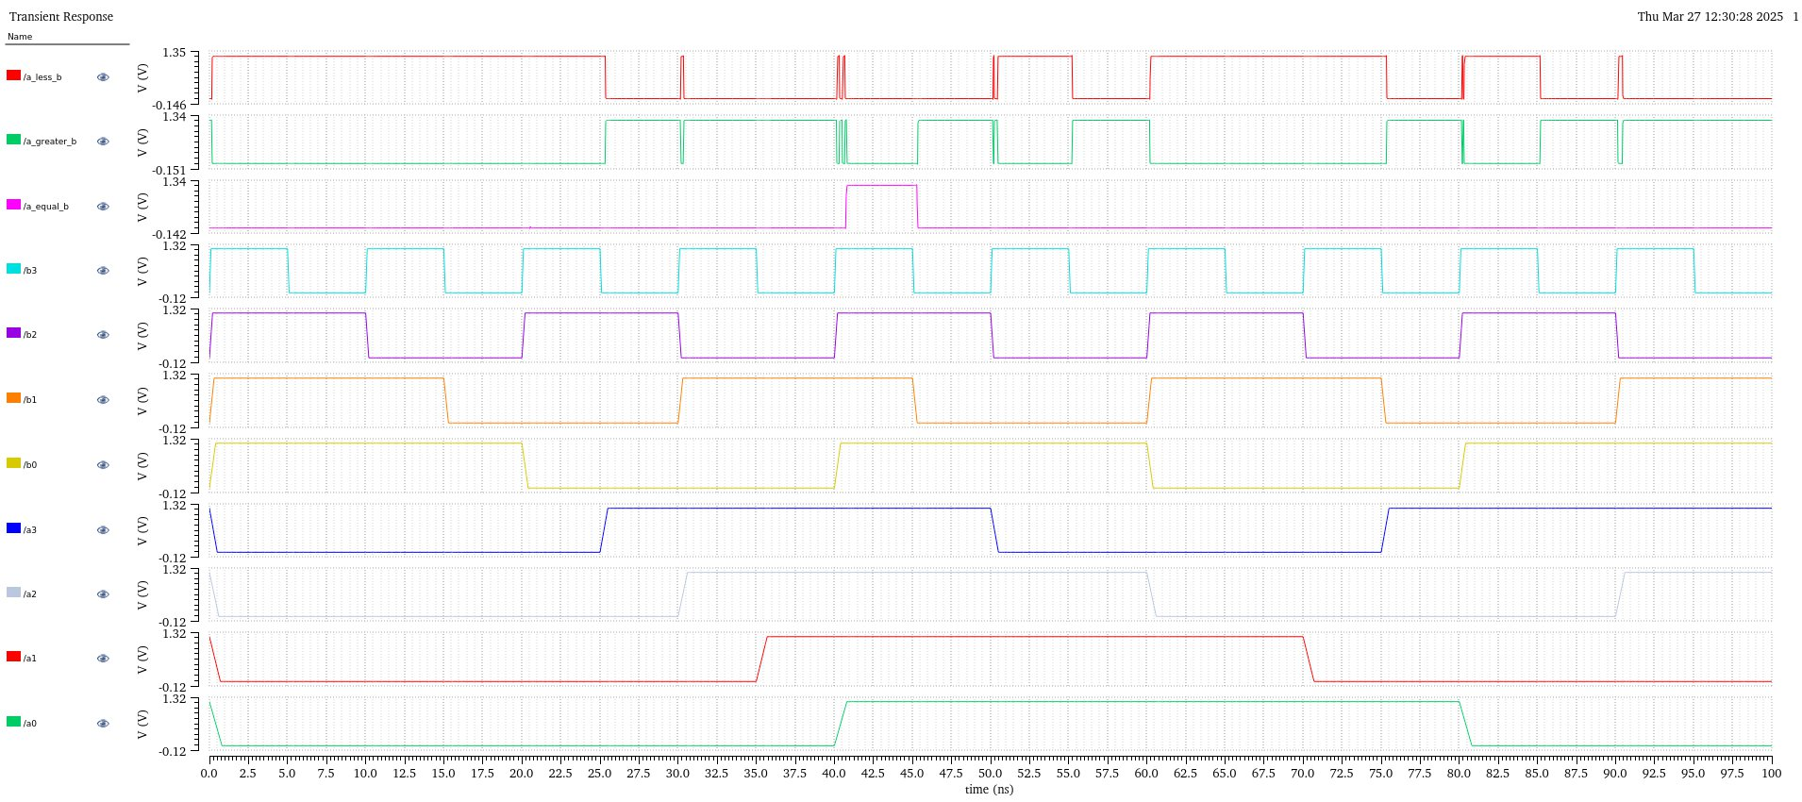
4-BIT COMPARATOR USING FA(NAND GATES) OUTPUT

Slide 28
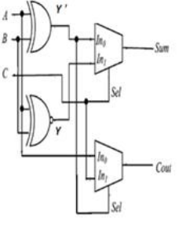
FULL ADDER USING 1-XNOR,1-XOR AND 2 MUX
First XOR gate
Inputs → A,B
Output → Y=A⊕B
First XNOR gate
Inputs → A,B
Output →Y′=A⊙B=(A⊕B)’
First Multiplexer (for Sum)
Inputs →
In0=Y
In1=Y’
Selection Line → C
Output →S=C⋅Y′+C⋅Y, by substituting we get,
➔>Sum=C⋅(A⊙B)+C⋅(A⊕B)
Second Multiplexer (for Carry-out)
Inputs →
In0=Y′
In1=Y
Selection Line → C
Output →Cout​=C⋅Y+C⋅Y′, by substituting we get,
➔>Cout​=C⋅(A⊕B)+C⋅(A⊙B)
Here from logic diagram
A, B → Two bits to be added
C → Carry-in

Slide 29
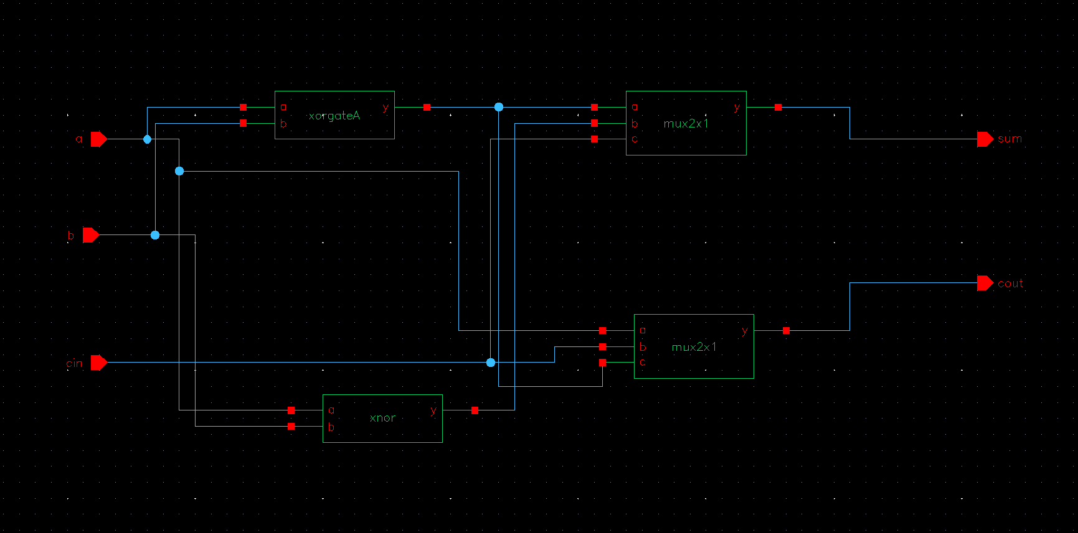
FULL ADDER USING 1-XNOR,1-XOR AND 2 MUX

Slide 30
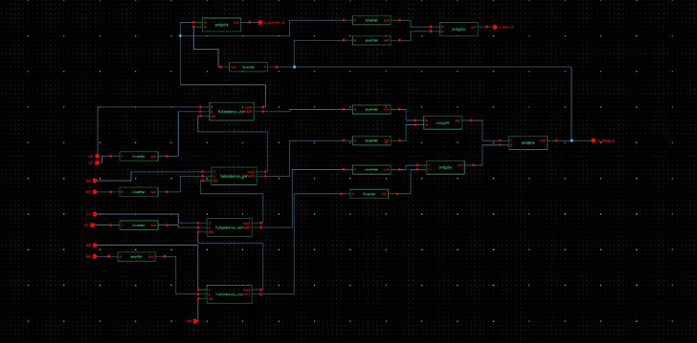
4-bit comparator using FA(x-nor xor 2 mux )

Slide 31
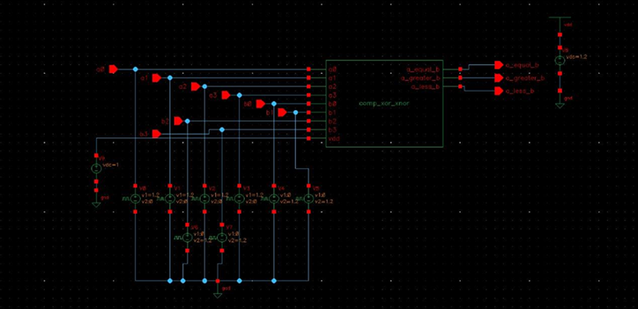
X-nor xor 2 mux Full adder Symbol and power connections

Slide 32
4 BIT COMPARATOR USING X-nor Xor 2 Mux FULL ADDER(output)

Slide 33
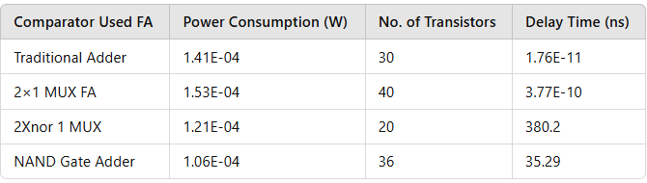
Simulation outputs:
Power Consumption is lower for Nand gate adder- (1.06E-04 W)
Number of Transistors : 2Xnor 1 MUX (20 transistors)
Delay Time: Traditional Adder (1.76E-11 ns)
So overall NAND gate adder comparator is best overall choice because if offers a good balance of 1. Lowest power consumption(Energy Efficient)=1.06E-04 2. Moderate number of transistor(Reasonable complexity)=36
3. Low delay(Acceptable Performance)=32.29ns

Slide 34
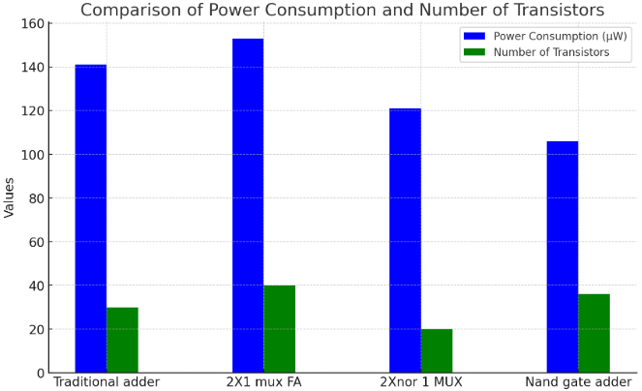
Power consumption and Number of Transistor comparison between FA comparator
Fig 11. Delay Comparison of Full Adder Based Comparators

Slide 35
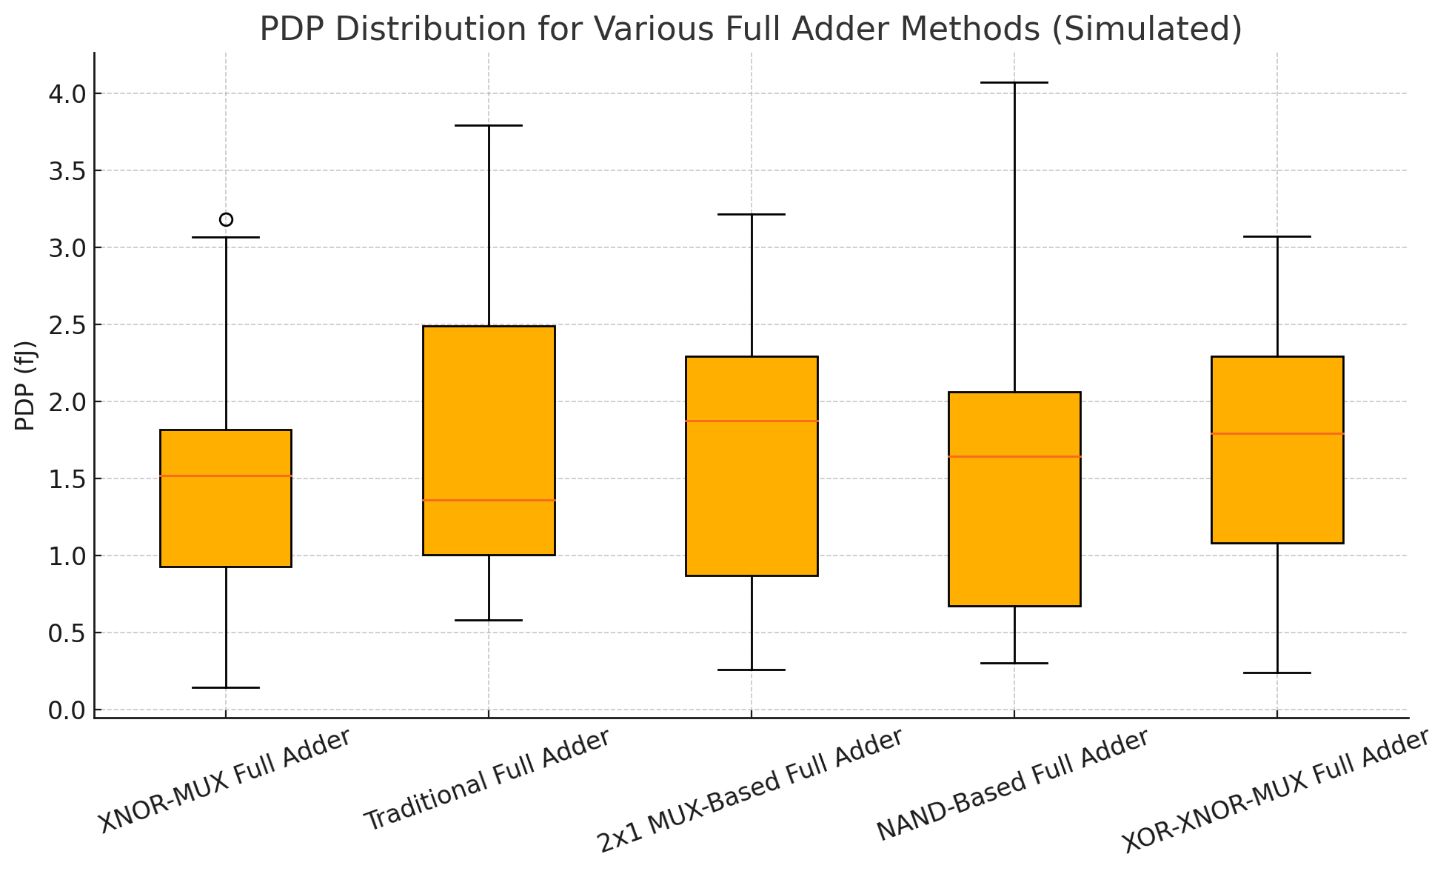
Fig 12. Power delay product (PDP) distribution for various full adder methods

Slide 36
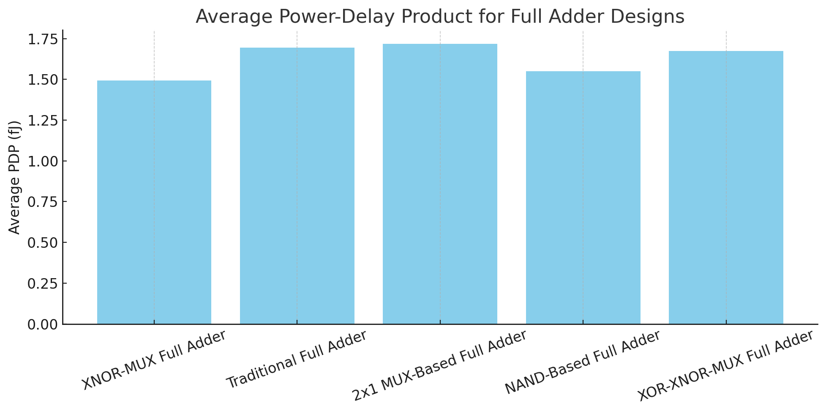
Fig 13. Average Power delay product (PDP) distribution for various full adder methods

Slide 37
Conclusion and Future Scope
The proposed 4-bit magnitude comparator was designed using five full adder architectures and evaluated using Cadence Virtuoso at 45nm. The NAND gate-based full adder emerged as the most efficient, with 106 μW power, 196 transistors, and 35 ps delay. The XNOR-MUX design offered the best power-delay efficiency for low-power applications. This work highlights the impact of transistor-level optimization in VLSI design. Future scope includes FPGA/ASIC implementation, exploring advanced technologies like FinFET, and integrating with AI hardware for enhanced energy efficiency and reliability.

Slide 38
References
A. Gupta, M. Khatri, S. K. Rajput, A. Mehra and S. Bathla, "Design of low power magnitude comparator," 2017 7th International Conference on Cloud Computing, Data Science & Engineering - Confluence, Noida, India, 2017, pp. 754-758, Doi: 10.1109/CONFLUENCE.2017.7943251.
V. Shekhawat, T. Sharma and K. G. Sharma, "2-Bit magnitude comparator using GDI technique," International Conference on Recent Advances and Innovations in Engineering (ICRAIE-2014), Jaipur, India, 2014, pp. 1-5, Doi: 10.1109/ICRAIE.2014.6909270.
G. Snehalatha and M. Anjikumar, "Stochastic Flash Analog to Digital Converter Compared with Conventional Resistor ladder Flash Analog to Digital Converter," 2022 International Conference on Futuristic Technologies (INCOFT), Belgaum, India, 2022, pp. 1-6, doi: 10.1109/INCOFT55651.2022.10094440.
K. Rajasekhar**, P. Sowjanya*, V. Umakiranmai*, R. Harish*, M. Krishna, Design and Analysis of Comparator Using Different Logic Style of Full Adder, Journal of Engineering Research and Applications www.ijera.com ISSN : 2248-9622, Vol. 4, Issue 4( Version 1), April 2014, pp.389-393.
Chandrahash Patel1 , Veena C.S2, comparator design using full adder, IJRET: International Journal of Research in Engineering and Technology eISSN: 2319-1163 | pISSN: 2321-7308
G. Snehalatha, S. Chennoji, S. L. Yele and S. S. Bakna, "Design of a Kickback Noise Reduction Technique for Dynamic Comparators based on XOR-NMOS Switches," 2025 International Conference on Visual Analytics and Data Visualization (ICVADV), Tirunelveli, India, 2025, pp. 691-697, doi: 10.1109/ICVADV63329.2025.10961748.
Vandana Choudhary Rajesh Mehra, 2- Bit Comparator Using Different Logic Style of Full Adder, International Journal of Soft Computing and Engineering (IJSCE) ISSN: 2231-2307, Volume-3, Issue-2, May 2013.
G. Sharma, H. Arora, J. Chawla and J. Ramzai, "Comparative analysis of a 2-bit magnitude comparator using various high performance techniques," 2015 International Conference on Communications and Signal Processing (ICCSP), Melmaruvathur, India, 2015, pp. 0079-0083, doi: 10.1109/ICCSP.2015.7322602.
G. Snehalatha, J. Selvakumar and E. Thuraka, "Design and Analysis of Low Power CNFET Based Current Steering Digital to Analog Converter," 2024 IEEE International Conference on Smart Power Control and Renewable Energy (ICSPCRE), Rourkela, India, 2024, pp. 1-6, doi: 10.1109/ICSPCRE62303.2024.10674943.
Abdullah-Al-Shafi, Md., & Bahar, A. N. (2016). Optimized design and performance analysis of novel comparator and full adder in nanoscale. Cogent Engineering, 3(1). https://doi.org/10.1080/23311916.2016.1237864

Slide 39
Dr. Madhu Sudan Chakraborty, Designing an On-Line Magnitude Comparator for Higher-Radix, International Journal of Information Technology and Electrical Engineering, Volume 9, Issue 4, ISSN: - 2306-708X, August 2020.
M. Sagar, M. Singh, S. Singh and R. Gupta, "Analysis of Different Magnitude Comparator Using Subtraction Logic," 2018 International Conference on Intelligent Circuits and Systems (ICICS), Phagwara, India, 2018, pp. 11-16, doi: 10.1109/ICICS.2018.00015.
S. N. K, G. Snehalatha, C. V. Raj and M. N. Goud, "Energy-Efficient Level Crossing ADC for Biomedical Applications: High-Precision Signal Acquisition with Ultra- Low Power Consumption," 2025 International Conference on Inventive Computation Technologies (ICICT), Kirtipur, Nepal, 2025, pp. 1819-1824, doi: 10.1109/ICICT64420.2025.11005335.
Chopde, A., Dupare, K., Ganvir, T., Dhumal, S. (2024). A 4-Input 8-Bit Comparator with Enhanced Binary Subtraction. In: Kumar, S., Hiranwal, S., Garg, R., Purohit, S.D. (eds) Proceedings of International Conference on Communication and Computational Technologies. ICCCT 2023. Lecture Notes in Networks and Systems, vol 1121. Springer.
Vijaya Krishna Boppana, N. V., & Ren, S. (2016). A Low-Power and Area-Efficient 64-Bit Digital Comparator. Journal of Circuits, Systems and Computers, 25(12), 1650148.
Chua, C., Kumar, R.: ‘An improved design and simulation of low-power and area-efficient parallel binary comparator’, Microelectron. J., 2017, 66, pp. 84– 88.
Ajaykumar S Kulkarni1 , Nikhil N Amminabhavi2 , Akash A F3 , Aditya Parvati4, Design and Implementation of 16-Bit Magnitude Comparator Using Efficient Low Power High Performance Full Adders, Journal of Engineering Research and Applications, ISSN : 2248-9622, Vol. 4, Issue 8( Version 2), August 2014, pp.120-124.
V. Anbumani, S. Padmapriya, S. Soviya, S. Sneha and L. Saran, "An Efficient VLSI design of Median Filters using 8-bit Data Comparators in Image Applications," 2022 6th International Conference on Devices, Circuits and Systems (ICDCS), Coimbatore, India, 2022, pp. 317-321, doi: 10.1109/ICDCS54290.2022.9780671.
G. Snehalatha, J. Selvakumar and E. Thuraka, "Design of 8-bit Low power & High performance SAR ADC using current steering DAC," 2023 Global Conference on Information Technologies and Communications (GCITC), Bangalore, India, 2023, pp. 1-6, doi: 10.1109/GCITC60406.2023.10426165.
Meena Aggarwal, Rajesh Mehra, Performance Analysis of Magnitude Comparator using Different Design Techniques, International Journal of Computer Applications (0975 – 8887) Volume 115 – No. 14, April 2015.
Venishetty, S. R. ., & Chidra , A. K. . (2021). Design of power efficient, high-speed 4-bit comparator in UMC 180 nm technology. Engineering and Applied Science Research, 48(1), 40–47.
S. Lubaba, K. M. Faisal, M. S. Islam and M. Hasan, "Design of a Two-Bit Magnitude Comparator Based on Pass Transistor, Transmission Gate and Conventional Static CMOS Logic," 2020 11th International Conference on Computing, Communication and Networking Technologies (ICCCNT), Kharagpur, India, 2020, pp. 1-5, doi: 10.1109/ICCCNT49239.2020.9225501.
Operation," 2019 International Conference on Computer Communication and Informatics (ICCCI), Coimbatore, India, 2019, pp. 1-4, doi: 10.1109/ICCCI.2019.8822197.

Slide 40


